Slide 1


REVERSE ENGINEERING
AI Navigation System
Architecture, algorithms, data flow and redesign
REAL-WORLD CASE
Google Maps navigation — a conceptual reconstruction based on publicly documented system behavior.
B Santhosh Kumar
Guided By
Dr Rajaram P
Reg No: 192511053

Slide 2
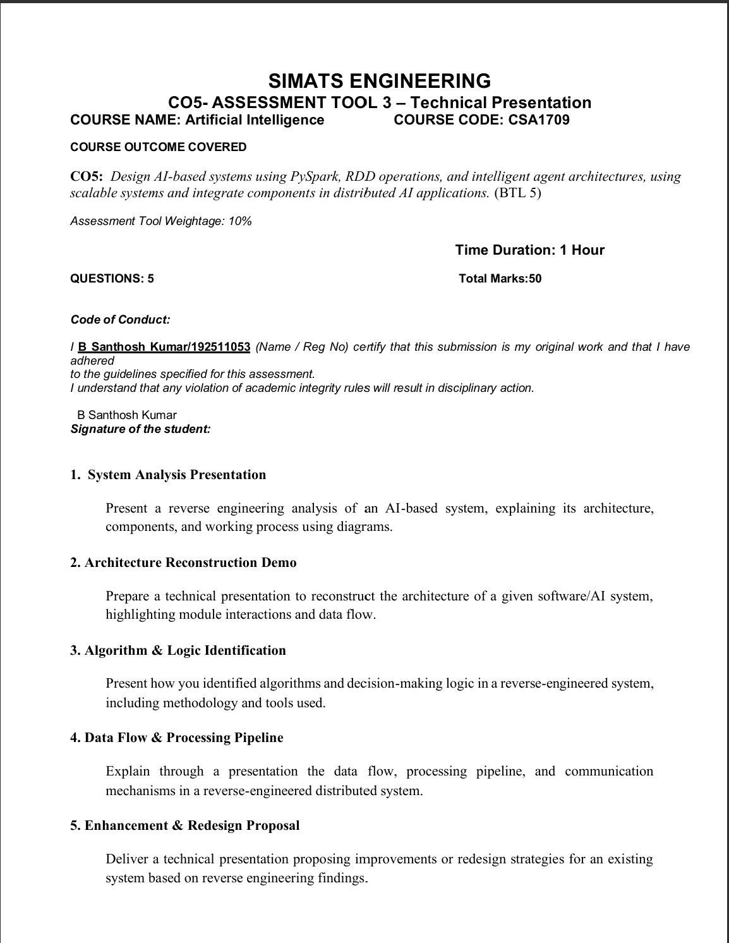

Slide 3
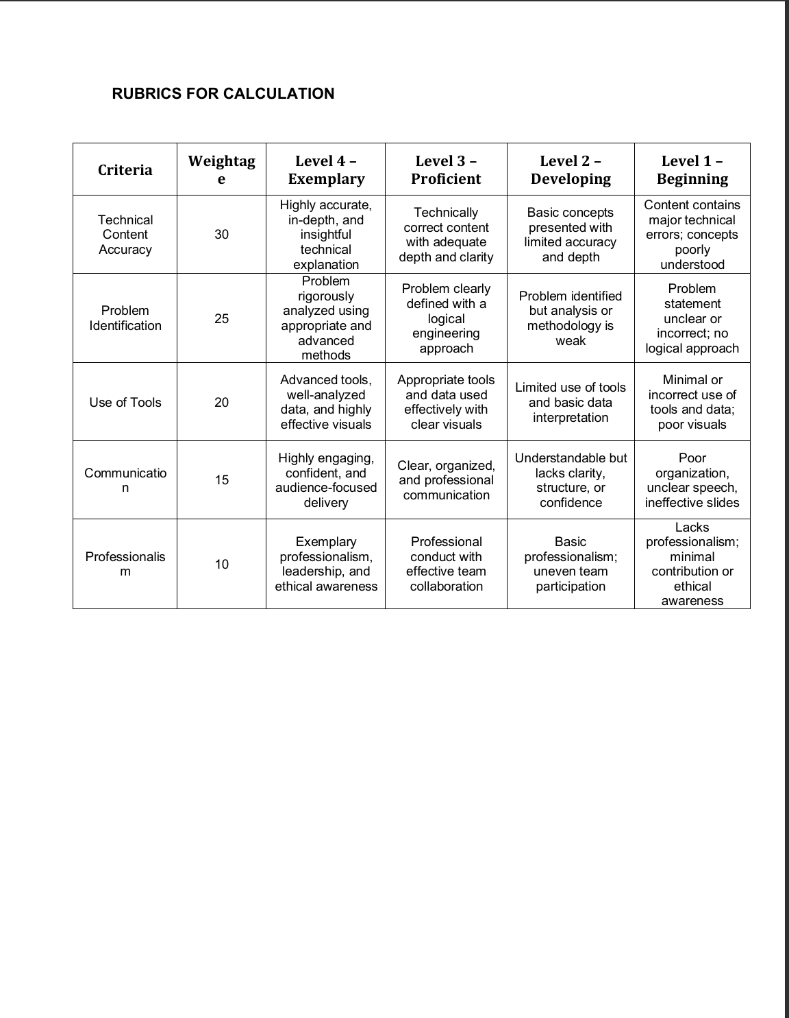

Slide 4

1. System Analysis
What we can observe before looking inside the system
Inputs
Outputs
GPS location Destination Road network Traffic observations
Route ETA Traffic condition Rerouting / alerts
Main observation
The system combines live road conditions with historical patterns, predicts near-future traffic, then uses that information to select or change a route.
Objective
Infer the smallest architecture that explains these visible behaviors.

Slide 5
2. Reconstructed Architecture
A practical engineering view of the major modules
Mobile / Navigation App
GPS, destination, route display, voice guidance
Data Layer
Location signals, road graph, incidents, historical traffic
AI Prediction
Traffic forecasting and ETA estimation
Routing Engine
Candidate routes, constraints and route ranking
Response Layer
Best route, ETA, alerts and rerouting
Conceptual reconstruction — not Google's private source-code architecture.

Slide 6
3. Data Flow & Module Interaction
How information moves through the system
GPS / User
Traffic Data
AI Prediction
Route Engine
Navigation
Incidents
Road Graph
Feedback
1. Collect
2. Predict
3. Generate routes
4. Rank
5. Deliver
The feedback loop matters: new road conditions can trigger another prediction and route decision.

Slide 7
4. Algorithm & Logic Identification
Algorithms inferred from the behavior and public technical evidence
Traffic Prediction
Route Selection
Decision Logic
• Historical traffic patterns • Live traffic observations • Machine learning • Graph Neural Network (publicly documented by Google DeepMind) • Travel-time prediction
• Candidate route generation • ETA comparison • Road restrictions • Road quality • Directness / road size • Alternative route when predicted congestion rises
IF route is restricted → reject IF predicted delay rises → compare alternatives IF alternative has lower cost → reroute ELSE → continue current route
Public technical evidence identifies a Graph Neural Network traffic-prediction component and a route-ranking stage.

Slide 8
5. Route Scoring Logic
A simple formula that explains the engineering trade-off
Illustrative comparison
Lower total cost → preferred feasible route
Route
ETA
Traffic
Cost
A
28 min
High
41
B
31 min
Medium
36
C
25 min
High risk
43
Values are illustrative, not Google Maps measurements.
Decision
Choose the lowest-cost route that satisfies road, safety and user constraints.

Slide 9

6. Real-World Example: Chennai Commute
A normal navigation decision, shown step by step
08:20
Start
Driver enters destination.
08:24
Observe
Traffic speed drops on current route.
08:25
Predict
Model estimates additional delay.
08:26
Compare
Routing engine checks alternatives.
08:26
Reroute
Lower-cost route is recommended.
08:31
Update
Fresh observations trigger another check.
This mirrors Google's publicly described example of predicting future congestion and rerouting a driver before the jam is reached.

Slide 10
7. Enhancement & Redesign Proposal
Improvements derived directly from the reverse-engineering findings
Problem Found
Proposed Change
Expected Benefit
Black-box decisions can be hard to explain. AI predictions may become less reliable during unusual traffic conditions. A delayed service can make a route decision stale.
Add prediction confidence. Separate safety / road constraints from ML. Add deterministic fallback routing. Store route-decision reason codes.
More explainable routes Safer failure handling Easier testing Better monitoring Clearer debugging and governance
Design principle: use AI for prediction, but keep critical constraints deterministic and auditable.

Slide 11
8. Reverse-Engineering Method
How the architecture and logic were identified
Observe
Decompose
Hypothesize
Validate
Document
Record inputs, outputs and edge cases.
Separate UI, data, AI and routing responsibilities.
Map behavior to likely algorithms and services.
Check whether the model explains multiple scenarios.
Produce architecture, data-flow and decision diagrams.
Tools
Validation
Browser/app observation • API traces • Python • diagrams • logs
Scenario testing • boundary cases • timing checks • comparison of outputs
Ethical boundary: inspect only public behavior or systems you are authorized to test.

Slide 12
9. Conclusion
One reverse-engineering process connects all five assessment areas
Analyze
Reconstruct
Identify
Trace
Improve
Understand visible inputs, outputs and responsibilities.
Build the layered architecture and module interactions.
Infer algorithms and decision logic from evidence.
Follow data through prediction, routing and delivery.
Redesign for explainability, resilience and governance.
Final takeaway
Reverse engineering is not guessing the source code; it is creating the smallest technical model that explains the system's observed behavior.
Key sources: Google Maps 101 (2020); Google DeepMind traffic prediction (2020); Google Maps India AI updates (2023–2025).

